Slide 1
Storyboard Template
ACTS Team

Slide 2
Menu
This process will be repeated for each module
Each section/sub-module will be a Menu item.
Create a Client
Update a client
Delete a Client
Review a Client
Waitlist a client

Slide 3
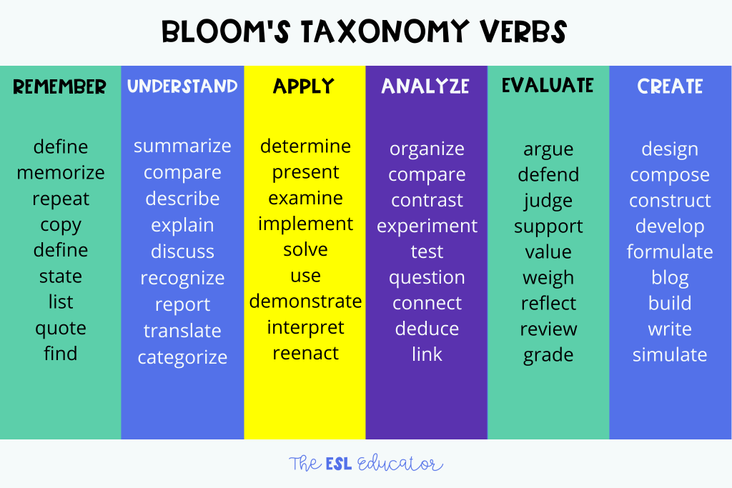
Learning Objectives (Create a Client)
At the end of this module you will be able to –
Describe….
Demonstrate..
Navigate to…
Use action verbs from Blooms Taxonomy to describe Learning Objectives.

Slide 4
Elearning course
Module 1
Module 2
Module 3
Module 4
<Learning Objectives>
-
-
-
<Learning Objectives>
-
-
-
<Learning Objectives>
-
-
-
<Learning Objectives>
-
-
-

