Slide 1
Nurse Practitioner Encounter Coding
Focused Review
Care of the Elderly CoP
June 2025
Marita Gove
VCH NP Lead

Slide 2
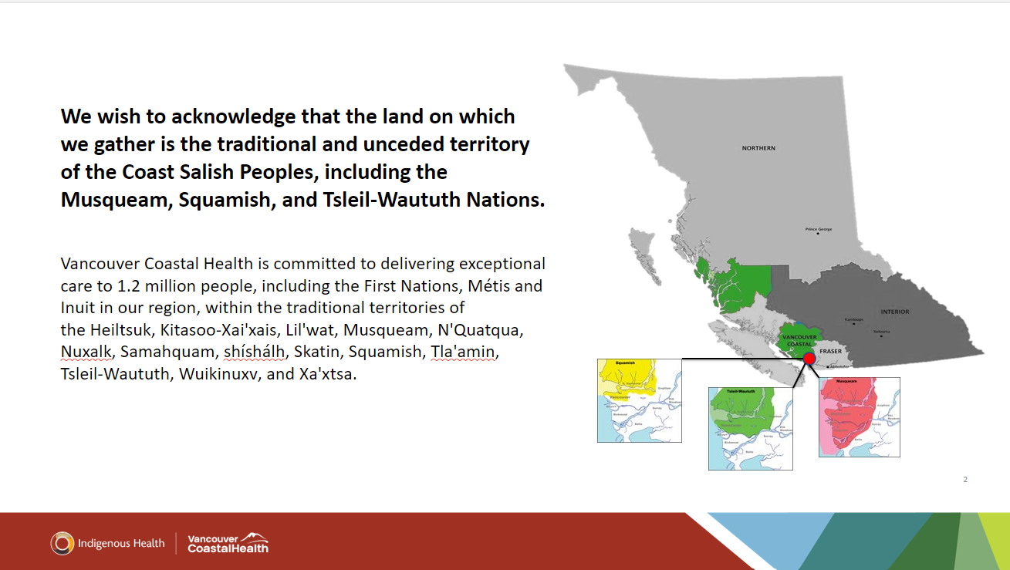

Slide 3
Objectives
Convey
Convey importance of encounter reporting for NPs
Review
Review important forms for successful submission to MSP
Provide
Provide overview of simplified encounter codes specific to your practice environment and a focused review of coding as it applies to your practice
Allow
Allow for discussion of tips and tricks for successful encounter coding

Slide 4
Why do we care about NP Encounter Reporting
REQUIRED of NPs by MOH
Show NP work to provide data that can maintain current and create additional funding
Empower NPs to review their encounter coding, analyze trends and allow for continuous growth and improvement
Stepping stone for:
Showing complexity
SDOH coding
Upcoming changes to NP direct billing

Slide 5
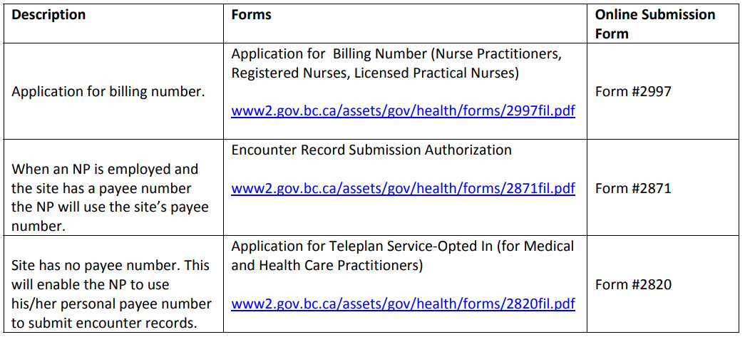
Steps needed for successful MSP submission
If you receive an error code in final step of encounter reporting, these steps may be the answer​!
Reach out to your local operations or NP Lead for guidance
Encounter Record Submission Procedures

Slide 6
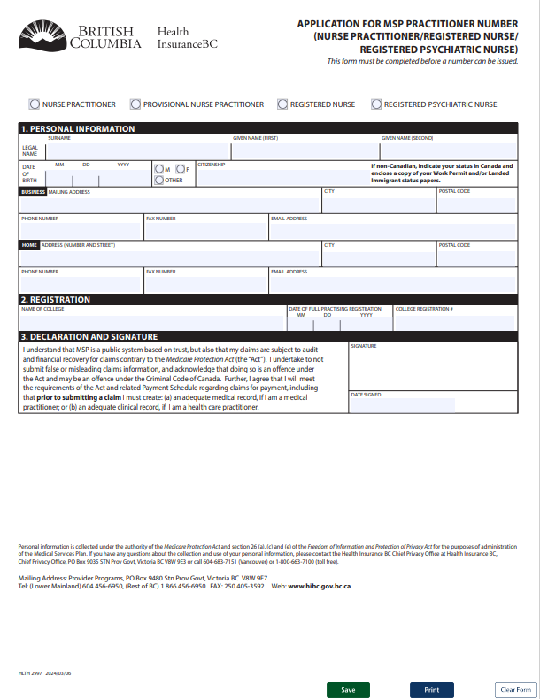
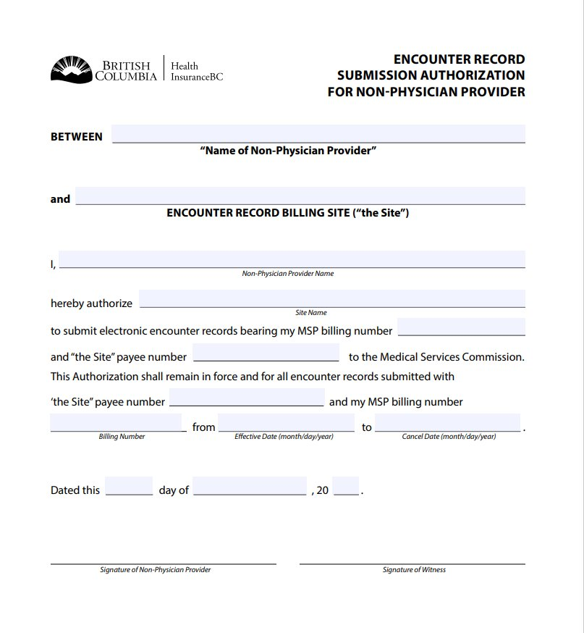
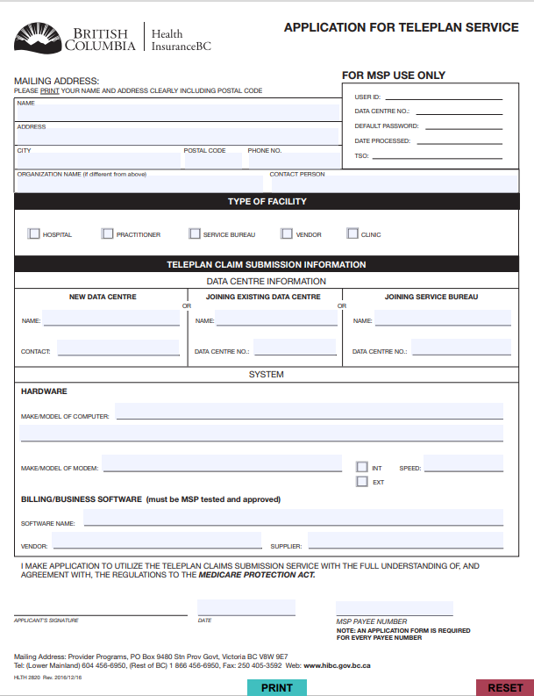
Application for MSP Practitioner Number (Nurse Practitioner, Provisional Nurse Practitioner, Registered Nurse, Registered Psychiatric Nurse)
Encounter Record Submission Authorization For Non-Physician Provider
Application for Teleplan Service​

Slide 7
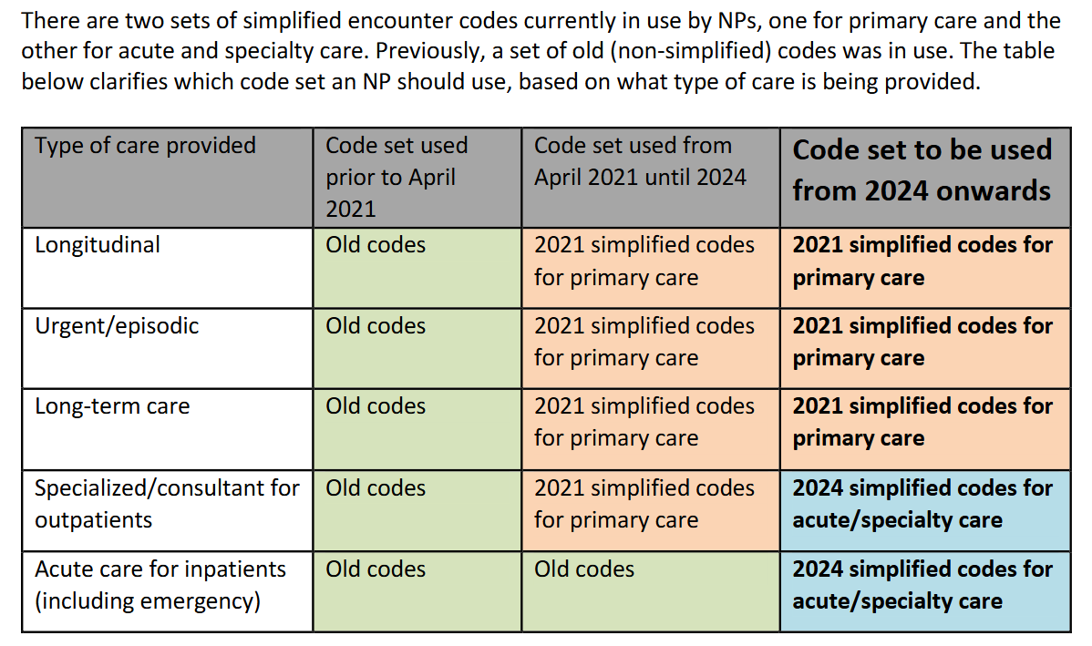
Simplified Coding

Slide 8
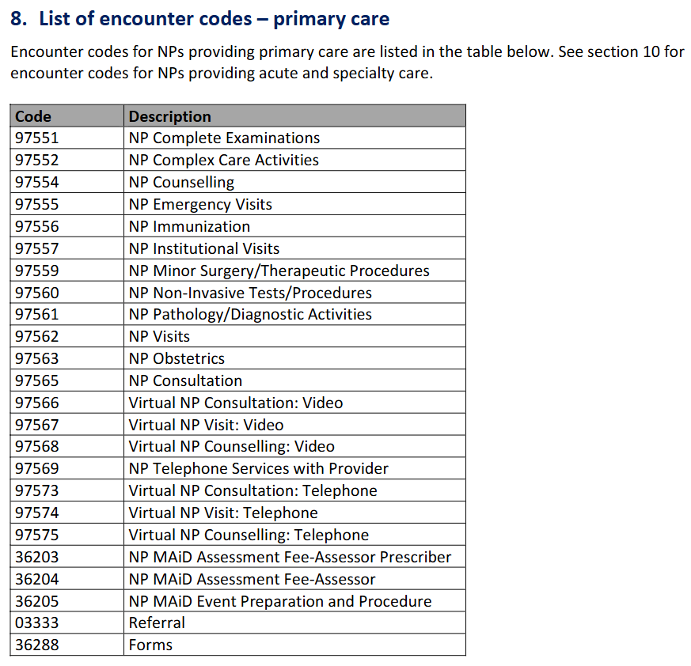
Quick Guide to Common Community Encounter Codes
Encounter_Reporting_for_NPs_updated_May_2024.pdf

Slide 9
Direct Care Visit Codes

Slide 10
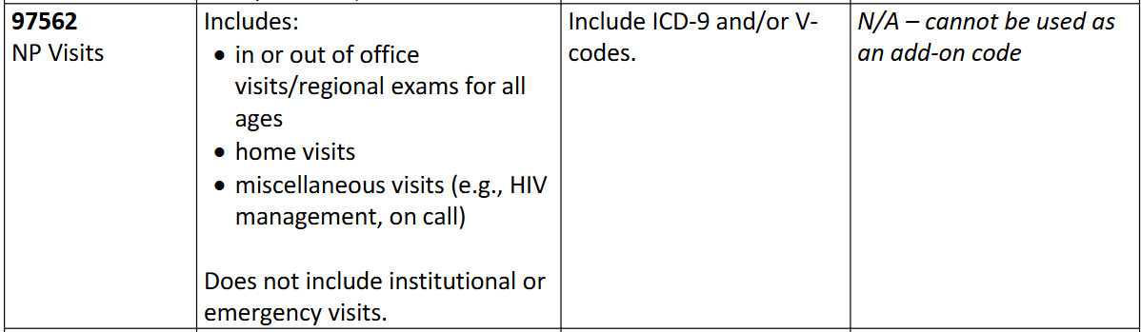



97562 – NP Visit
(in-person, office or home)

Slide 11
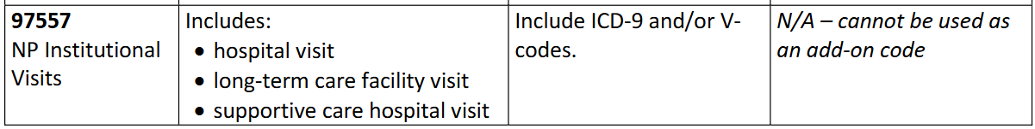

97557 – NP Institutional Visit
(in-person)

Slide 12
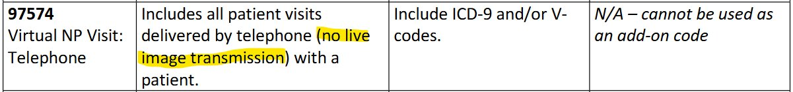
97574 – Virtual NP Visit: Telephone

Slide 13
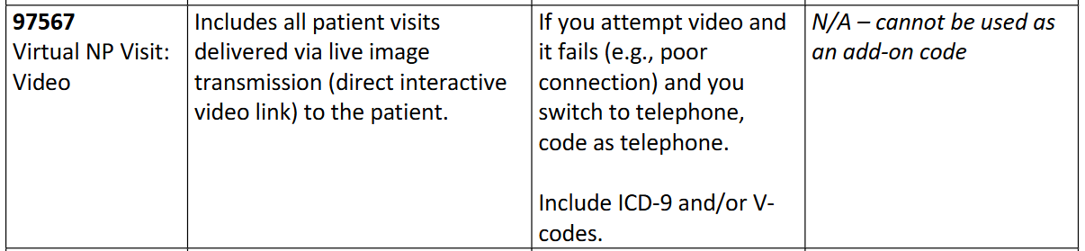


97574 – Virtual NP Visit: Video

Slide 14

Indirect Care Codes

Slide 15
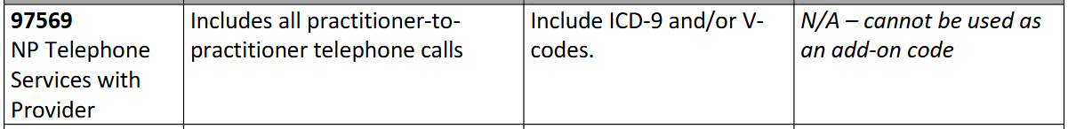


97569 – NP Telephone Services with Provider

Slide 16
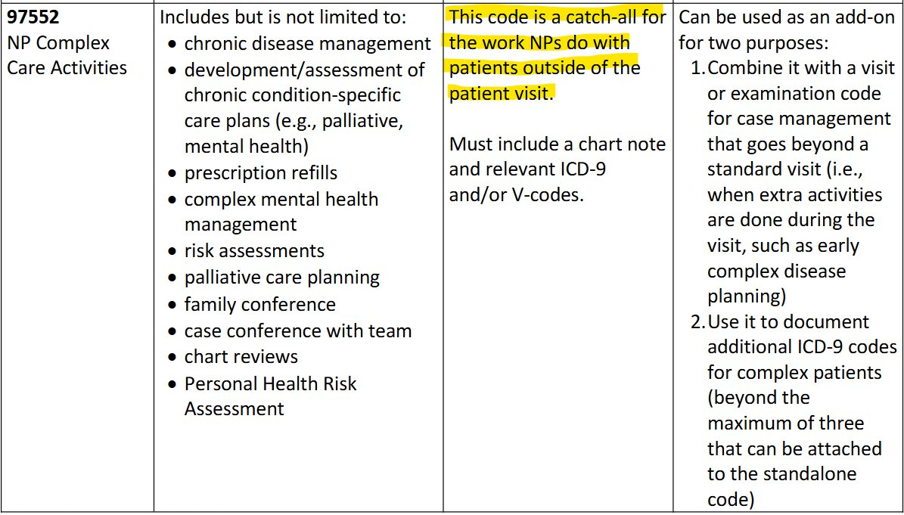
97552- NP Complex Care Activities

Slide 17
Profile EMR Encounter Reporting Tutorial
Part One:
https://ca01web.zoom.us/clips/share/BGNhMDEWTEpOY1hSblBSZEt5TnZyZnFlSVp2dwE
Part Two:
https://ca01web.zoom.us/clips/share/BGNhMDEWR1laZnVjSmtTZXV6alRRUHRFZFA1dwE

Slide 18
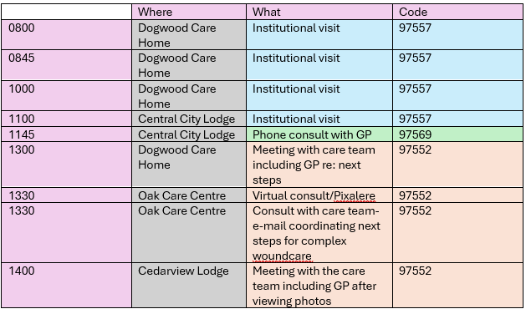
"A day in the life": encounter reporting as a Care of the Elderly NP

Slide 19
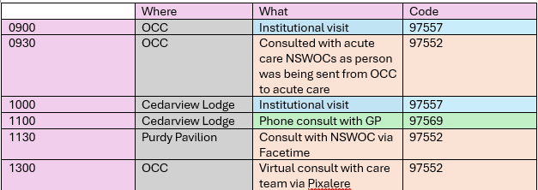
"A day in the life": encounter reporting as a Care of the Elderly NP

Slide 20
Share your tips and tricks!

Slide 21
Additional Concerns/Barriers
Encounter reporting (success or challenges) will be reviewed at all individual NP touchdowns with Leads and Directors, including annual reappointment/credentialing review meetings
If you are experiences any barriers to successful encounter reporting, you are expected to reach out to your NP Lead and/or Director for support

